Slide 1
MINDFULNESS TEACHER TRAINING PATHWAY

Slide 2
OUTLINE OF THE PATHWAY
UK Network for Mindfulness-Based Teacher Training Organisations membership and approach.
Training of mindfulness teachers with prior training in the fields of education, health and wellbeing, or community service.
LEVEL 1: MINDFULNESS FOUNDATIONS
LEVEL 2: TEACHER DEVELOPMENT PRACTICUM
LEVEL 3: TEACHER DEVELOPMENT IMMERSION
LEVEL 4: TRAINING-THE-TRAINER

Slide 3
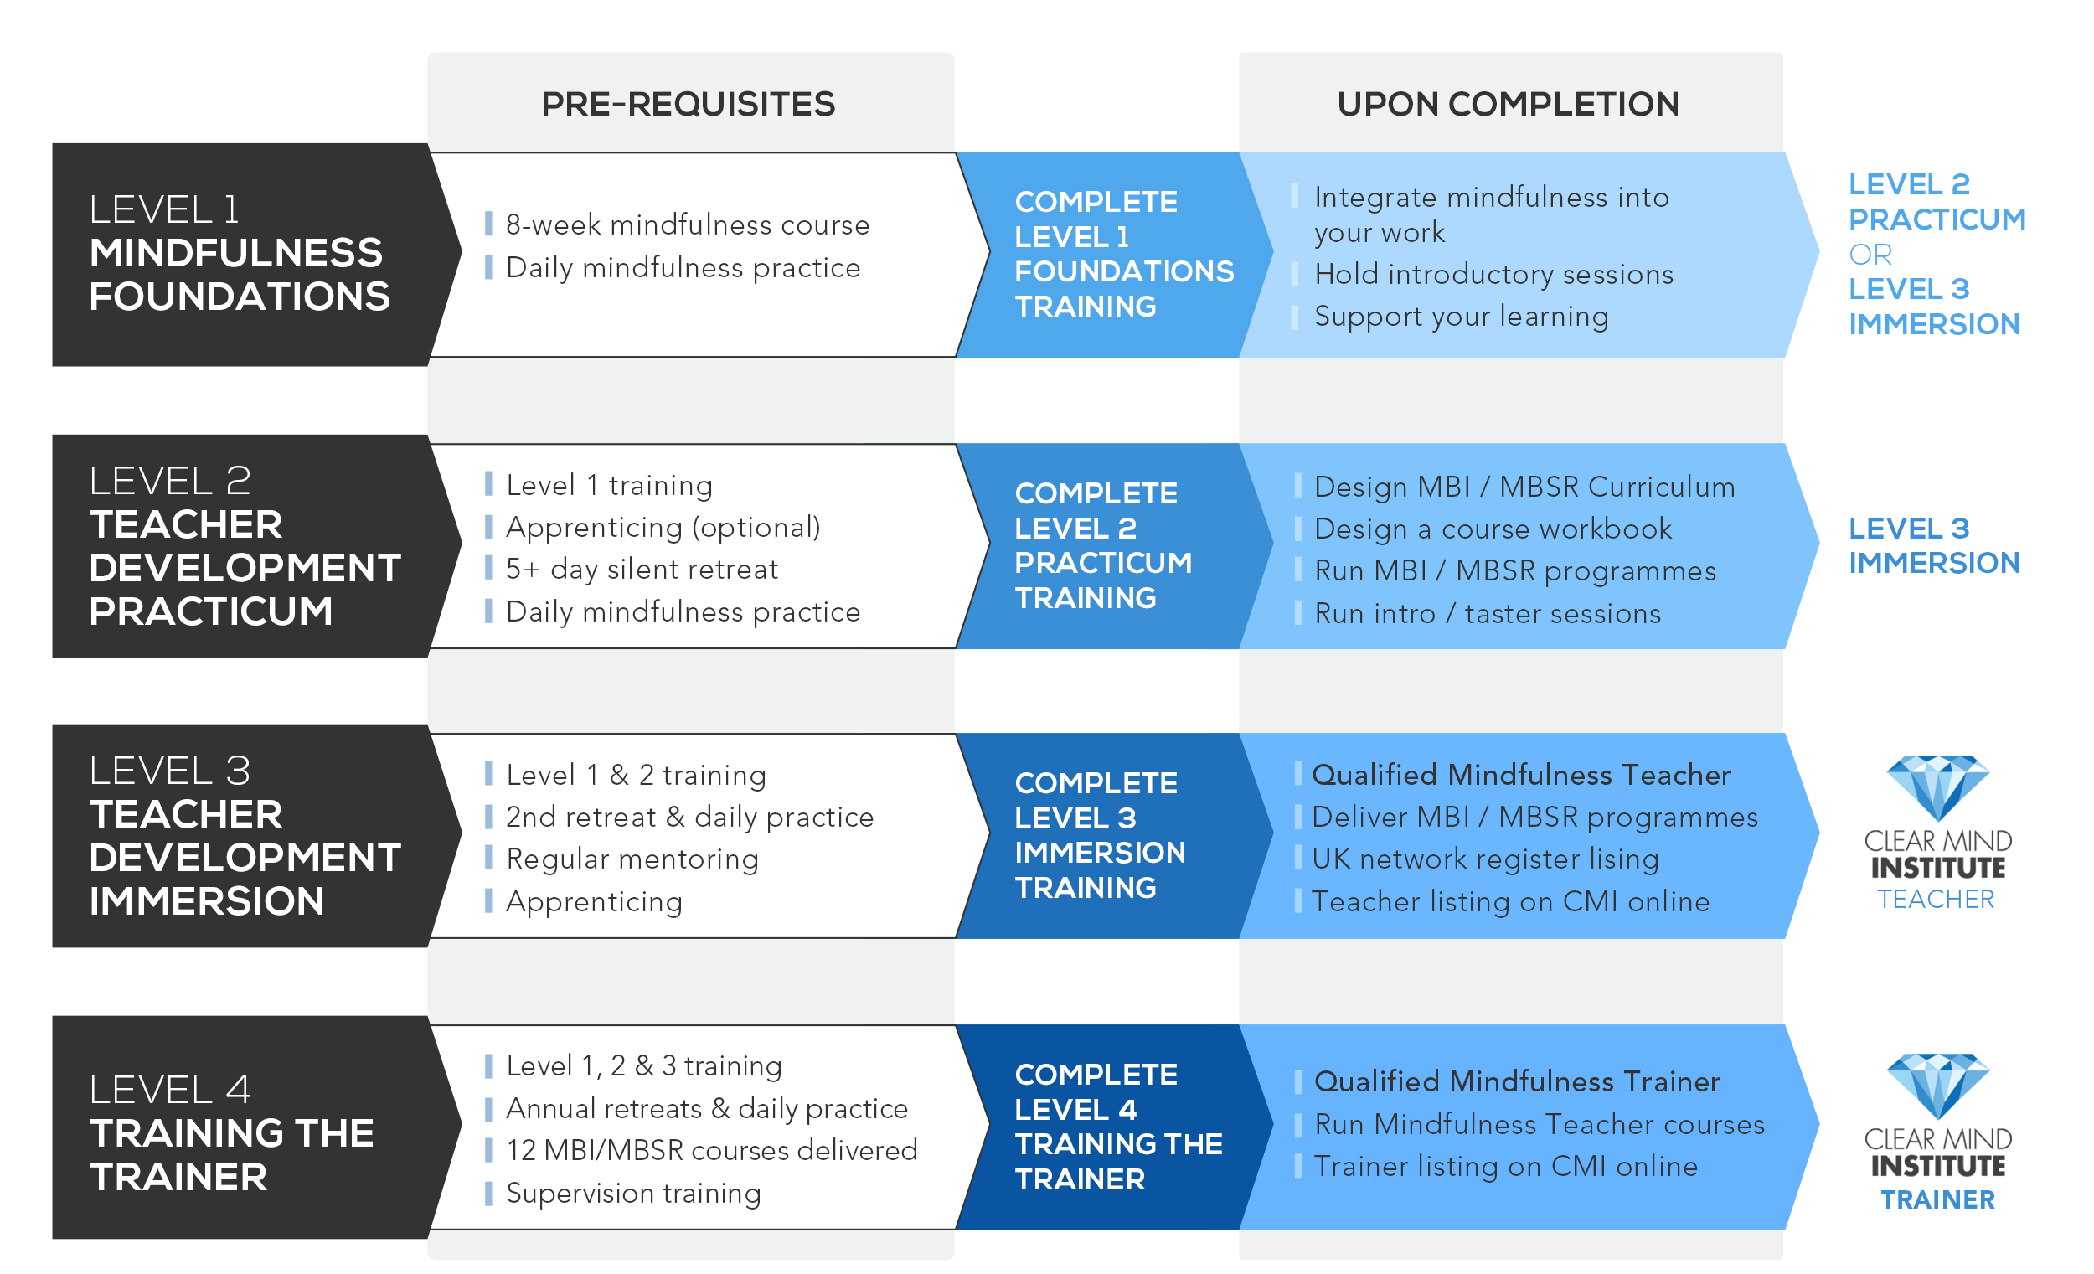
CMI TRAINING PATHWAY
This is to allow greater flexibility in the way students can train.
PLEASE NOTE:
Full qualification as a Mindfulness Teacher requires completion of Level 1, 2 & 3.
Kindly refer to each section for full details.

Slide 4
LEVEL 1 MINDFULNESS FOUNDATIONS

Slide 5
AIMS & OBJECTIVES
1
LEVEL 1: MINDFULNESS FOUNDATIONS
Deepen experience and appreciation of the principles and practices of mindfulness
Explore mindfulness through direct lived experience accompanied by reflection in groups, pairs and through silence in practice
Examine and apply the theoretical and ethical foundations of mindfulness
Consider effective integration of mindfulness into working life
Design appropriate, small-scale mindfulness interventions

Slide 6
PRE-REQUISITES
1
LEVEL 1: MINDFULNESS FOUNDATIONS
AN 8-WEEK MINDFULNESS PROGRAMME (Ideally taken in a group setting)
Sets the ground for direct experience of the programme as well as reflective learning
Familiarises participants with the flow of the course and the method
Re-experiencing the programme as a teacher trainee offers the added perspective of re-experiencing the process afresh
A DAILY MINDFULNESS PRACTICE
Shown to improve attentional and emotional regulation
Daily practice hones ethics and values and cultivates mindful compassion
The quality and duration of training are important: what is being cultivated?

Slide 7
LEARNING OUTCOMES
1
LEVEL 1: MINDFULNESS FOUNDATIONS
Explore the MBSR programme in relation to its overarching ethos, elements, curriculum, design and delivery methods
Examine the principles and practice of mindfulness through conversation and dialogue, and in silence
Uncover innate resourcefulness in meeting stress, anxiety, pain, loss, and suffering as it presents in us, through interactions with others and through life events
Explore avenues that support flourishing of the heart and mind
Recognise the attitudes and language essential to the formal and informal guidance and cultivation of mindfulness
Work in dyads and small groups to practice delivery of some of the formal mindfulness practices

Slide 8
UPON COMPLETION OF LEVEL 1
1
LEVEL 1: MINDFULNESS FOUNDATIONS
You may integrate mindfulness into your work
Incorporating brief versions of some of the formal practices into your therapy / counselling / yoga teaching / body work / community service
You may hold introductory sessions that combine your work with mindfulness
If continuing on to Level 2, it would be helpful to:
find a group to sit with
set up mentoring sessions
find a retreat to participate on
It is not possible to call yourself a mindfulness teacher nor a CMI teacher

Slide 9
LEVEL 2 TEACHER DEVELOPMENT PRACTICUM

Slide 10
AIMS & OBJECTIVES
2
LEVEL 2: TEACHER DEVELOPMENT PRACTICUM
Educate and train healthcare professionals, yoga teachers, therapists, counsellors, community workers and others who qualify, in MBIs and MBSR
Discuss and investigate the theoretical, pedagogical and human components of mindfulness programmes
Familiarize participants with the Mindfulness-Based Interventions-Teacher Assessment Criteria (MBI-TAC) guidelines with regard to competencies in teaching
Consider mindfulness interventions within the larger socio-political context
Investigate the growing evidence base both in support of and in critical appraisal of MBIs; encouraging critical appraisal of the literature
Contribute towards the growth and development of an international community of mindfulness practitioners and professionals who serve disadvantaged groups

Slide 11
PRE-REQUISITES
2
LEVEL 2: TEACHER DEVELOPMENT PRACTICUM
Level 1 Fundamentals training
Apprenticing on an 8-week course is required before teaching. Apprenticing prior to Level 2 enhances this training and hones the appreciation of pedagogical and theoretical underpinnings, teacher qualities as well as the knowledge and skills embedded in the MBSR programme.
A 5+ day silent, residential, teacher-led retreat
A personal daily mindfulness practice

Slide 12
LEARNING OUTCOMES
2
LEVEL 2: TEACHER DEVELOPMENT PRACTICUM
Discern fundamental features of MBSR, how these are embedded within the curriculum and consider suitable approaches to course delivery
Distinguish, practice and receive feedback on foundational language principles
Develop experience, competency and aptitude in leading aspects of the curriculum with opportunities to learn through observation as well as receiving and offering feedback
Investigate aspects of relationality in the MBI setting both internally and within dyads and the larger group
Collectively explore current mindfulness research

Slide 13
UPON COMPLETION OF LEVEL 2
2
LEVEL 2: TEACHER DEVELOPMENT PRACTICUM
Design an MBI or MBSR Curriculum
Design a workbook to support your course
Undertake two introductory MBI’s or MBSR programmes, with guidance and reflection
Run introductory mindfulness workshops
Deliver mindfulness taster sessions
Lobby your workplace or local council to support mindfulness interventions

Slide 14
LEVEL 3 TEACHER DEVELOPMENT IMMERSION

Slide 15
AIMS & OBJECTIVES
3
LEVEL 3: TEACHER DEVELOPMENT IMMERSION
Investigate the theoretical, pedagogical, ethical and philosophical underpinnings of MBSR and MBIs
Explore the Good Practice Guidelines as well as use of the MBI-TAC
Demonstrate knowledge and skill in guiding mindfulness practices and presentation components of the MBSR programme, accompanied by inquiry
Incorporate detailed peer and teacher feedback in on-site practice teachings
Emphasise and demonstrate precision and skill in language used to guide practices, inquiry and class dialogue
Reinforce teaching in accordance with embodiment, pacing, languaging, holding the space and other competencies

Slide 16
PRE-REQUISITES
3
LEVEL 3: TEACHER DEVELOPMENT IMMERSION
Level 1 and Level 2 training
Apprenticing on an 8-week course
A 5+ day silent, residential, teacher-led retreat (ideally a second such retreat)
Regular mentoring
Demonstration of mindfulness competence submitted through the application process
A personal commitment to learning, growing, becoming whole and a dedication to the wellbeing of all

Slide 17
LEARNING OUTCOMES
3
LEVEL 3: TEACHER DEVELOPMENT IMMERSION
Examine the MBSR curriculum with special regard to ethos, theory, content, underpinnings, presentation, delivery and the role of the teacher
Communicate understanding of the above through active engagement, teaching, inquiry and discussion
Convey the use of appropriate mindfulness language in guiding formally, informally and in general engagement in the process
Demonstrate mindful compassion and embodiment in the tone of voice, sensitivity, patience, kindness and quality of presence

Slide 18
UPON COMPLETION OF LEVEL 3
3
LEVEL 3: TEACHER DEVELOPMENT IMMERSION
YOU ARE NOW A FULLY QUALIFIED MINDFULNESS TEACHER
You may deliver full MBI or MBSR programmes
After successfully completing two supervised MBSR programmes, you are eligible to apply for listing on the UK Network Register
Should you wish to, you will be listed on the CMI website as a CMI teacher
After the completion of a satisfactory number of courses, you may take supervision and mentoring training

Slide 19
LEVEL 4 TRAINING THE TRAINER

Slide 20
AIMS & OBJECTIVES
4
LEVEL 4: TRAINING THE TRAINER
A year-long training based on apprenticing and mentoring sessions, both individual and group-based
The approach reinforces deep understanding of the intention behind mindfulness programmes as well as the design and delivery of the curriculum
Participants participate in supervised teaching of components of Levels 1, 2 and 3 to gain hands-on experience
Participants produce a portfolio of teaching and learning to demonstrate competency and heart

Slide 21
PRE-REQUISITES
4
LEVEL 4: TRAINING THE TRAINER
Completion of all other CMI Levels
Regular, ongoing practice
Successful delivery of 12 mindfulness courses, two of which are supervised
Listing on the UK Register of Mindfulness Teachers
Completion of Supervision Training
Annual attendance at silent, teacher-led, residential retreats

Slide 22
LEARNING OUTCOMES
4
LEVEL 4: TRAINING THE TRAINER
1.1 Convey through teaching, pedagogical, theoretical and attitudinal underpinnings
1.2 Communicate a grasp of the teaching components of the Level 1 training
1.3 Illustrate an understanding of adult-learning models and principles
1.4 Identify choice points in the process that exemplify cultivation of mindful compassion
2.1 Demonstrate proficiency in imparting ethics and managing learner expectations
2.2 Discern primary Level 2 ethos, elements and methods
2.3 Skill in enhancing group interaction to create a vibrant learning environment
3.1 Convey core philosophical and wisdom underpinnings fluently
3.2 Communicate the programme tenets in secular fashion to promote inclusivity
3.3 Facilitate group learning that enriches and reveals the course’s rich tapestry

Slide 23
SEQUENCE OF TRAINING
IN SUMMARY: CMI TRAINING PATHWAY – AT A GLANCE
AFTER LEVEL 2 TRAINING… if you are ready and if suitable, you undertake an introductory 8-week course under supervision
UPON COMPLETION OF LEVEL 3… you have two full courses supervised, and, on the basis of the outcome, apply for listing on the UK Network Register with sufficient teaching experience under your belt
Level 2 & 3 training can be taken at any time after Level 1 and are essential to add value and depth to delivery of the 8-week programme
Level 4 training will be open to those who have completed 12 or more courses, and who have sufficient CPD and other experience in hand.

